Slide 1
Customer Life Time Value Segmentation & Prediction
Alireza Alizadegan

Slide 2


Why customer life time value?
Organizations rely on less than 20% of customers to generate 80% of revenue
5 times more costly to acquire new customers than to maintain existing ones

Slide 3
Data Collection

Slide 4
E-commerce Data
Payment Dataset
Product Dataset
*Order id
Value
Sequential
Type
Installment
*Product id
Category
Name length
Description length
Photo quantity
Weight
Length
Height width
Data Cleaning
Timestamp format
Feature labels
Missing values
Unnecessary columns
Order Dataset
*Order id
*Customer id
Purchas timestamp
Order status
Invoiced
Shipped
Delivered
Unavailable
Approval timestamp
Delivered courier
Delivered customer
Estimated delivery
Review Dataset
Item Dataset
Seller Dataset
Review id
*Order id
Score
Comment title
Comment message
Creation date
Answer timestamp
*Order id
Item id
*Product id
*Seller id
Price
Freight
*Seller id
Zip code
City
State
Feature Selection
Order | Date | Customer | Payment
Geolocation
Customer Dataset
Feature Engineering
*Customer id
Unique id
Zip code
City
State
Zip code
Latitude
Longitude
City
State
Customer | Recency | Frequency | Monetary

Slide 5
Data Cleaning
Timestamp format
Feature labels
Missing values
Unnecessary columns

Slide 6
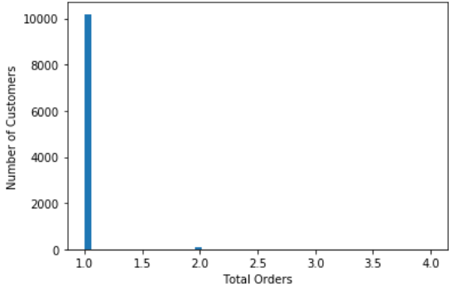
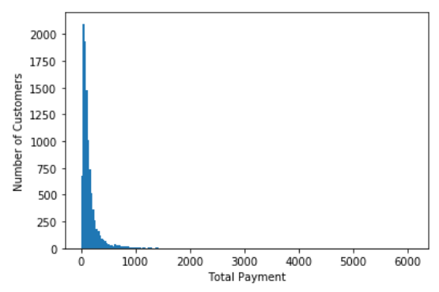
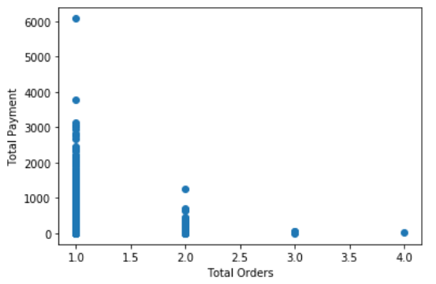
Exploratory Data Analytics

Slide 7
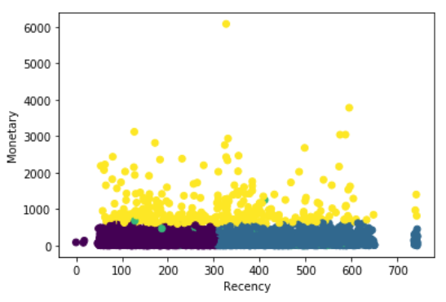
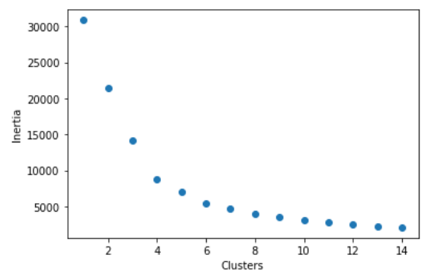
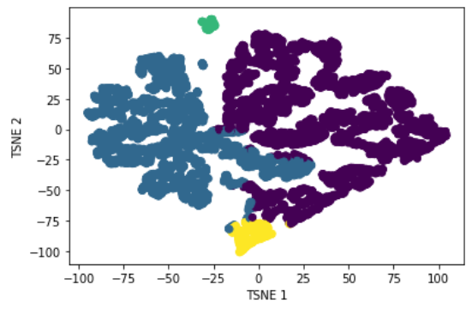
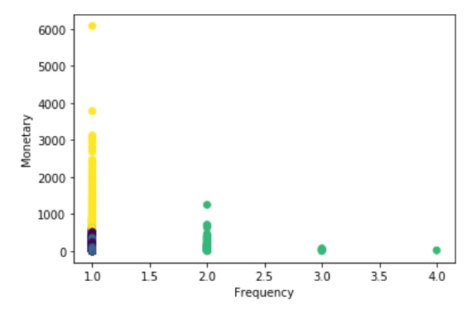
K-means Clustering

Slide 8
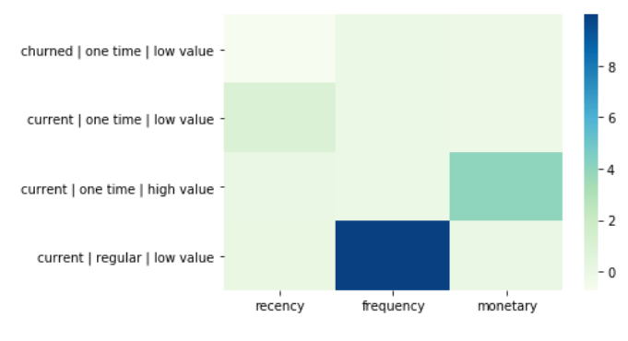
Marketing Strategies
276.4
1
155.1
NO ATTEMPT TO REAQUITE
LOST
WELCOME OFFER
NEW CUSTOMER
LOYALTY INCENTIVES
POTENTIAL LOYALIST
LOYAL CUSTOMER
MARKET NEW PRODUCTS

Slide 9
Plan of Action
Predict customer life time value over a time window
Predict churn rate
Identify products associated with negative customer sentiment

